Slide 1
Proposal | 2022-10-27
Accelerated Diffusion Models for
Protein Structure Generation
Haowei Lin, Shenshen Li, Yuzhe Wang
Peking University
{linhaowei, lssastar, wangyuzhe_ccme}@pku.edu.cn

Slide 2
Outline
Background
Applications of diffusion models
Algorithm sketch
Bottleneck of diffusion models
Previous Work
Forward process
Reverse process
Advanced modelling
Our Schedule

Slide 3
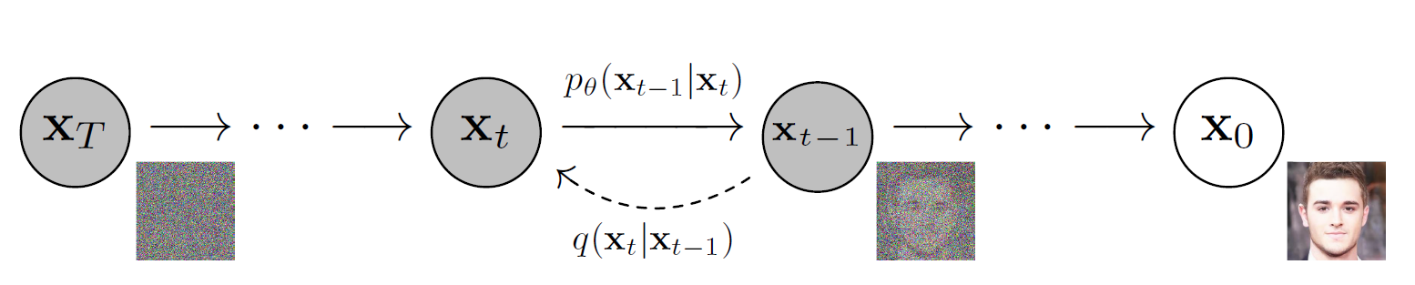
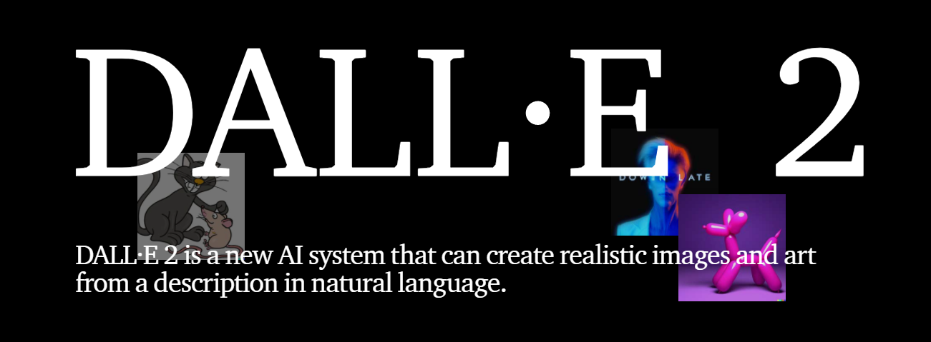
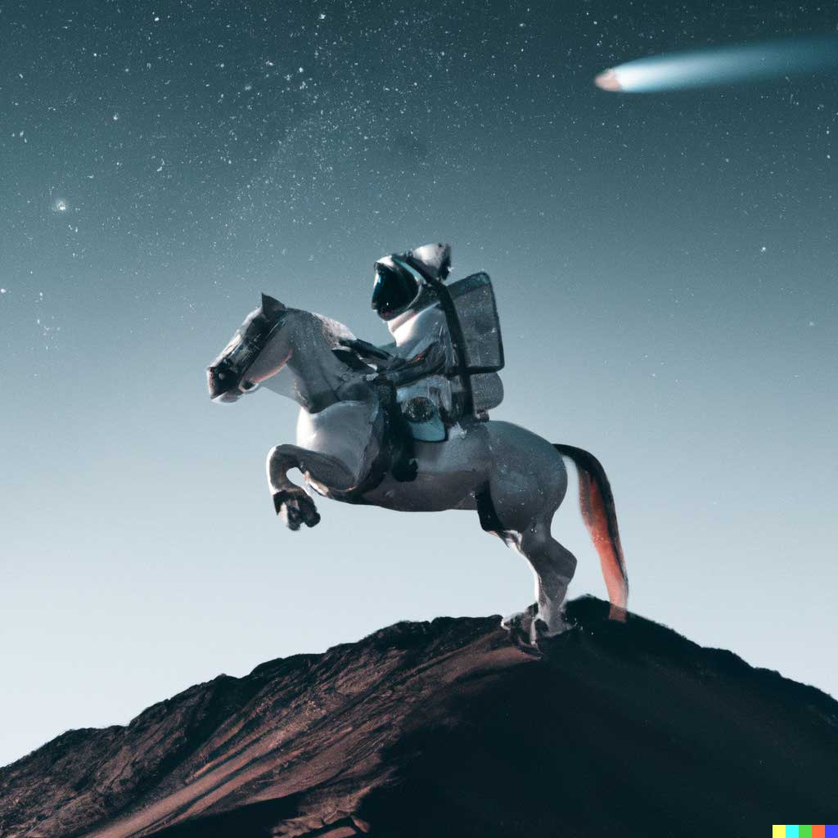
Background
https://openai.com/dall-e-2/
Ho J, Jain A, Abbeel P. Denoising diffusion probabilistic models[J]. Advances in Neural Information Processing Systems, 2020, 33: 6840-6851.
Notes:
bottleneck

Slide 4
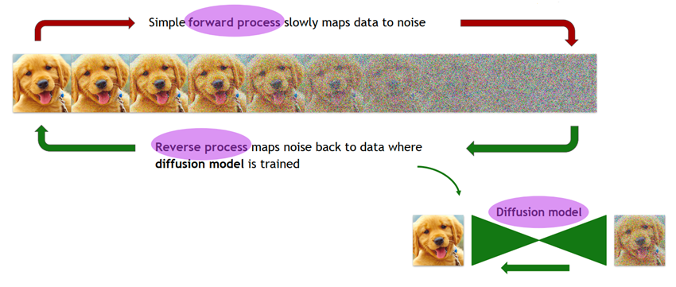
Previous Work
Forward process
Reverse process
Advanced modelling
Ho J, Chan W, Saharia C, et al. Imagen Video: High Definition Video Generation with Diffusion Models[J]. arXiv preprint arXiv:2210.02303, 2022.

Slide 5
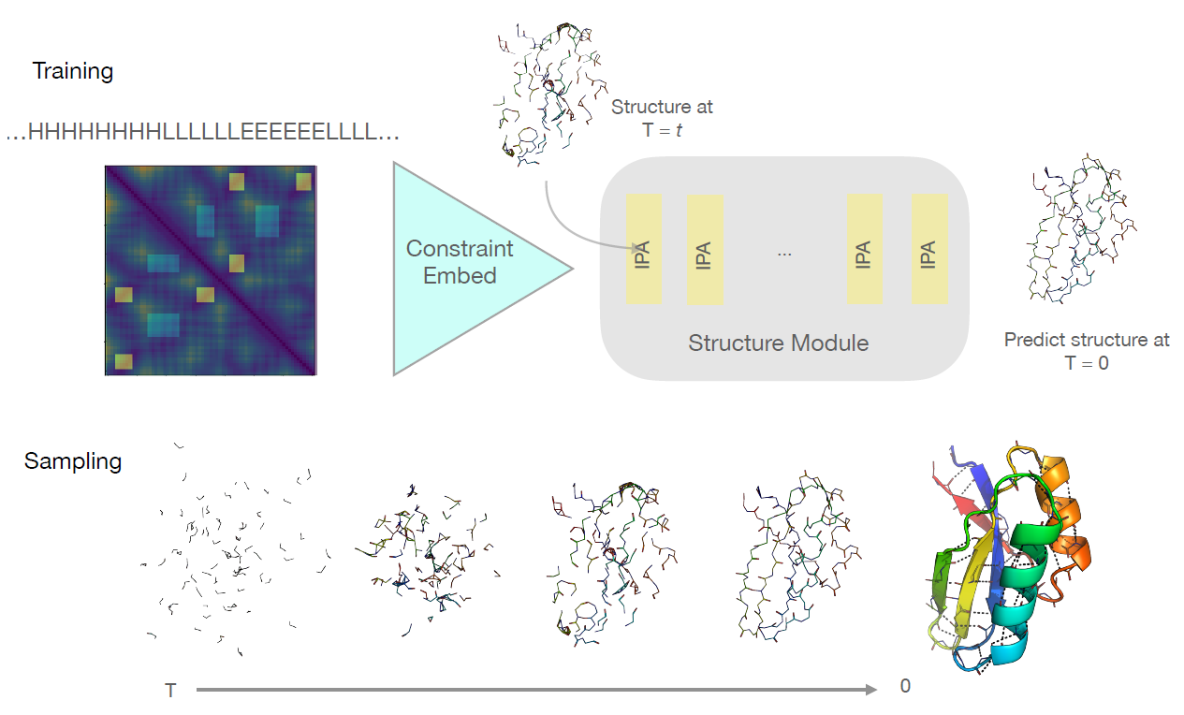
Our Schedule
Accelerated diffusion models for protein structure generation
Anand N, Achim T. Protein Structure and Sequence Generation with Equivariant Denoising Diffusion Probabilistic Models[J]. arXiv preprint arXiv:2205.15019, 2022.

Slide 6
Thank you
Haowei Lin, Shenshen Li, Yuzhe Wang
Peking University
{linhaowei, lssastar, wangyuzhe_ccme}@pku.edu.cn

